Slide 1
Kidney Diseases Detection and Classification using CT Scanned Image
Under the guidance of,
Yuvarani S
Assistant Professor
Submitted by,
Ritesh Kumar Gupta (22MCA0184),
Abhishek Das (22MCA0187)

Slide 2
ABSTRACT
Kidney Diseases are the most painful urological disorders.
With the increase of bad lifestyle these diseases are getting common.
Proposed work aims to classify among normal Kidney, Kidney Stones, Tumor and Cyst.
SMOTE (Synthetic Minority Over-Sampling Technique) is employed to manage the imbalanced data.
CNN (Convolutional Neural Network) is further used for classification of images.

Slide 3
INTRODUCTION
There are numerous types of kidney diseases.
* Chronic Kidney Disease
* Kidney Stones
* Glomerulonephritis
* Polycystic Kidney Disease
* Urinary Tract Infection
Among these the most common ones are Kidney Stone, Cyst, and Tumor.

Slide 4
RELATED WORK
S.NO | PAPER DETAILS | OBJECTIVE | STRENGTH
1. | Guozhen Chen et al [1], Prediction of Chronic Kidney Disease Using Adaptive Hybridized Deep Convolutional Neural Network on the Internet of Medical Things Platform Publication:- IEEE 2020 | Detection of Chronic Kidney Disease using CNN. Enhancing the accuracy of the classification system by using algorithmic models. | AHDCNN model is showing highest accuracy compared to RNN, HNN, DNN, etc. Inputs given by radiologists shows promising results in classification of renal cell.

Slide 5
S.NO | PAPER DETAILS | OBJECTIVE | STRENGTH
2. | Hui Zhang et al [2], Automatic Kidney Lesion Detection for CT Images Using Morphological Cascade Convolutional Neural Network. Publication: IEEE, 2019 | Lesion detection tool using morphological cascade CNN. | Proposed cascade RCNN is outperforming in lesions detection. 2 morphological operations are used.
3. | Akanksha Soni et al [3], Kidney Stone Recognition and Extraction using Directional Emboss & SVM from computed Tomography Images. Publication: IEEE, 2020 | Recognition of Kidney Stone using Support Vector Machine (SVM) | System obtained 98.71% using only 156 CT samples. Useful for recognizing stones with less processing time.

Slide 6
S.NO | PAPER DETAILS | OBJECTIVE | STRENGTH
4. | T. Mangayarkarasi et al [4], PNN- based Analysis System to Classify Renal Pathologies in Kidney Ultrasound Images. Publication: IEEE, 2017 | Classification of Ultrasound Kidney images into four classes: Normal, Cyst, Calculi and Tumor using PNN (Probabilistic Neural Network) | Overall accuracy of 92.99%, sensitivity of 88.04% and Specificity of 97.33% is obtained.
5. | Pallavi Vaish et al [5], Smartphone Based Automatic Abnormality Detection of Kidney in Ultrasound Images. Publication: IEEE, 2016 | Automatic abnormality (cyst and stone) detection of kidney using Viola Jones algorithm and SVM classifier. | Developed app resulted with an accuracy of 90.91%. Beneficial in rural healthcare and emergency conditions where sonographers are unavailable.

Slide 7
S.NO | PAPER DETAILS | OBJECTIVE | STRENGTH
6. | Neethu Rose Thomas et al [6], An Automated Kidney Tumor Detection Technique from Computer Tomography Images Publication:- IEEE 2022 | Identification of kidney tumor area with the help of K mean clustering and K means segmentation. | An accuracy of 91.2% and dice coefficient of 87.7% is achieved with K-means clustering technique.

Slide 8
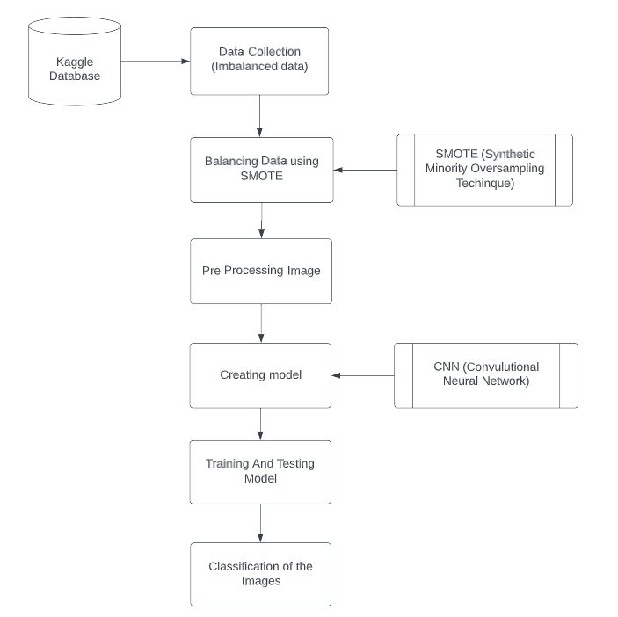
PROPOSED WORK

Slide 9
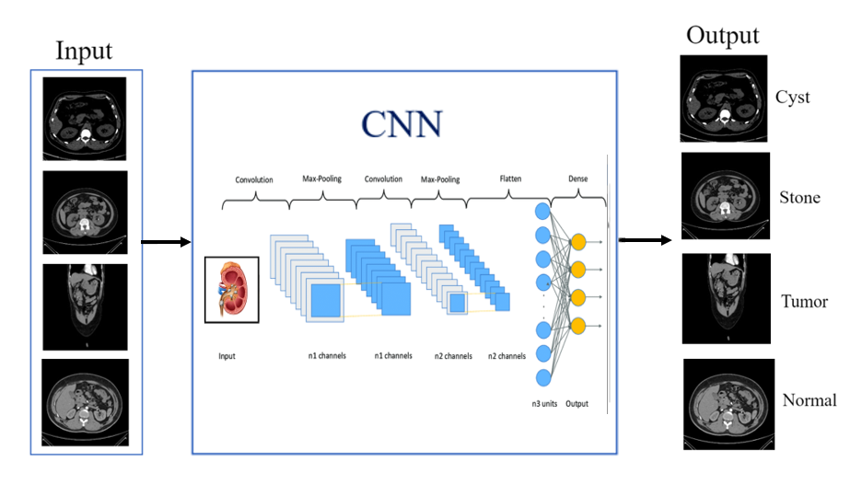
Architecture Design

Slide 10
CNN(Convolutional Neural Network)
Network Architecture for deep learning that learns directly from data.
Useful for finding patterns in images. Also employed to classify audio, time-series, and signal data.
It can be compared to the connectivity pattern of the brain.
In our project we will use this algorithm to classify different images as Kidney Stone, Cyst and Tumor.

Slide 11
Algorithm
Input : CT Scanned Image
Output : Classification
Process :
Step 1 : Converting the Imbalanced data to Balanced data using SMOTE.
Step 2 : Preprocessing the images -
2.1. Resizing the image
2.2. Normalization of the image
Step 3 : Creating the CNN model
3.1. Applying Convolution Layer
3.2. Applying Max-Pooling Layer
3.3. Flattening
3.4. Densing
Step 4 : Training the mode
Step 5 : Testing the model

Slide 12
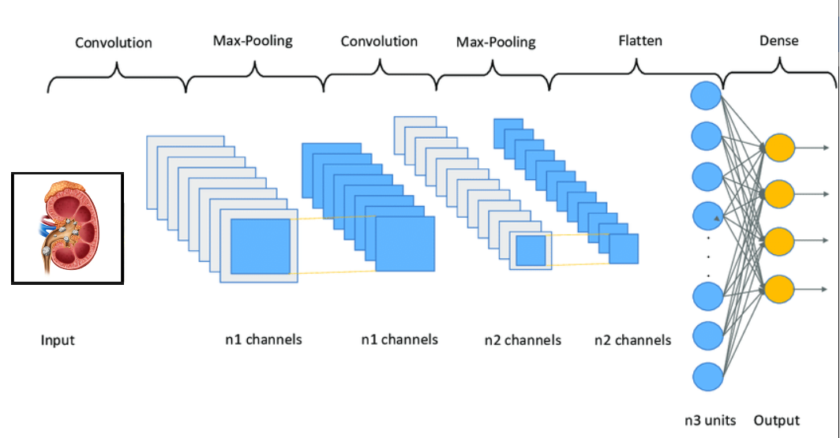
Working Methodology of CNN

Slide 13
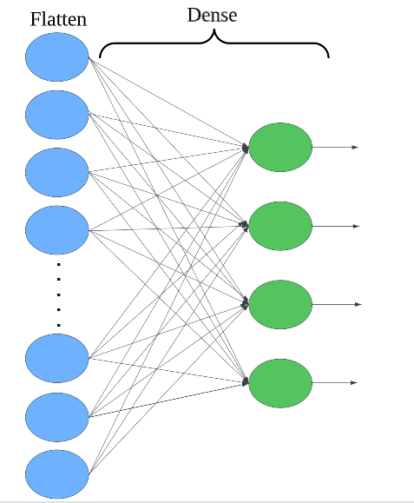
Dense Layers in Deep Learning

Slide 14
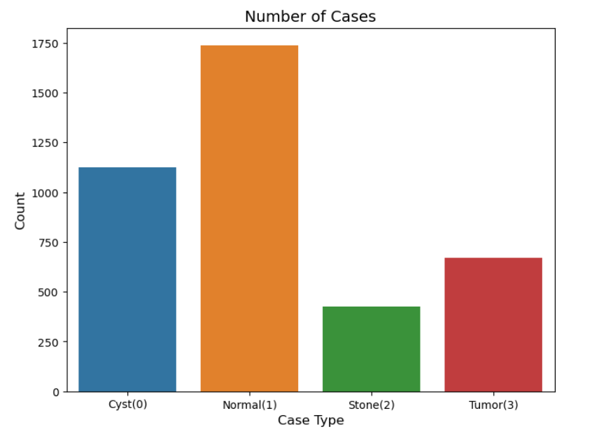
Available Data set (Imbalanced)

Slide 15
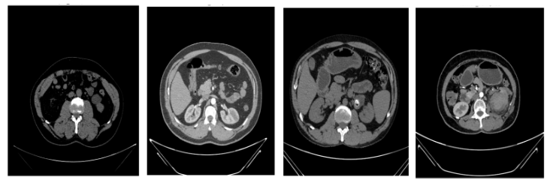
Available Data set (Imbalanced) cont…
Cyst
Normal
Stone
Tumor

Slide 16
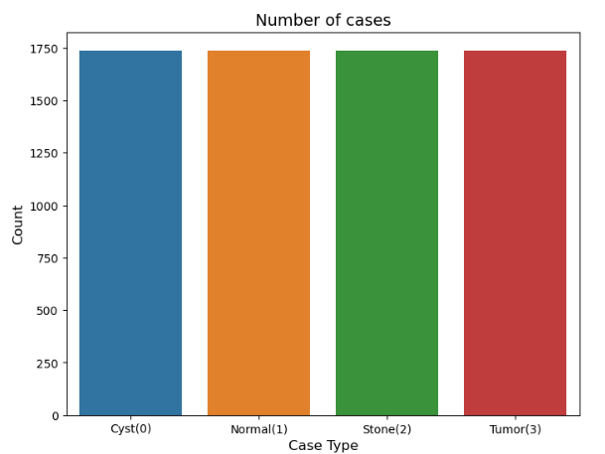
Balanced Data using SMOTE

Slide 17
SMOTE
SMOTE – Synthetic Minority Oversampling Technique
Technique for balancing the minority sample dataset from the available dataset.
Problem with Imbalanced dataset – It can give biased result based on the majority sample dataset.
Solution – Oversampling of minority sample is one of the techniques.
Oversampling – Duplicating the minority dataset. And this technique of oversampling is called SMOTE.

Slide 18
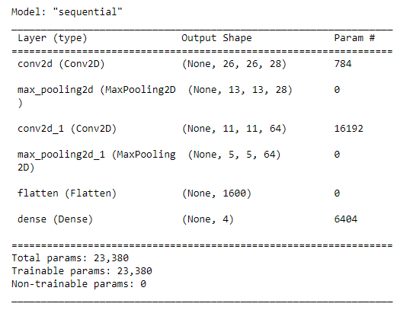
Model Summary

Slide 19
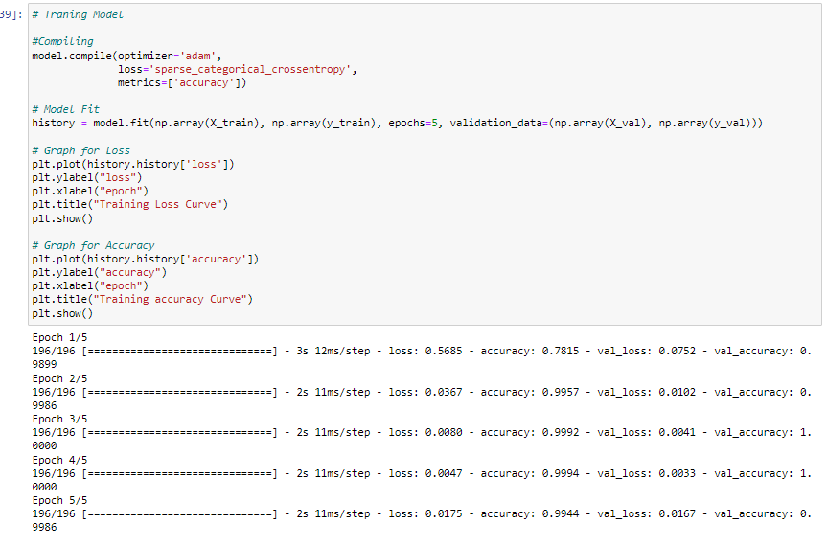
Results

Slide 20
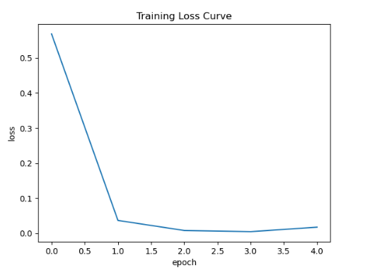
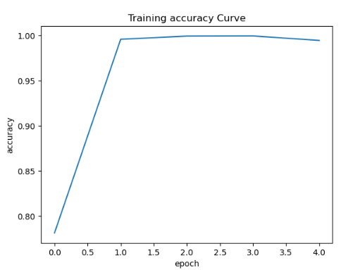
Loss and Accuracy Vs epoch
loss vs epoch accuracy vs epoch

Slide 21
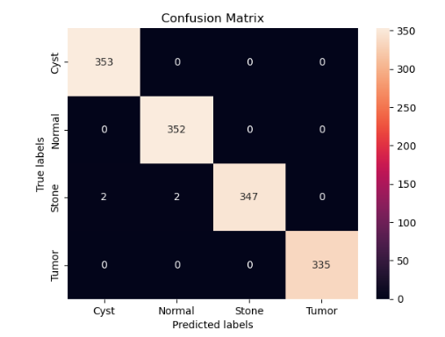
Confusion Matrix

Slide 22
Conclusion
Algorithm is able to classify most of the training image correctly.
Considerable improvement while training the algorithm with the increasing number of Epoch.
Loss is minimal after a particular number of Epoch.
Further research is needed to make algorithm compatible for robust data.

Slide 23
REFERENCES
[1] G. Chen et al., "Prediction of Chronic Kidney Disease Using Adaptive Hybridized Deep Convolutional Neural Network on the Internet of Medical Things Platform," in IEEE Access, vol. 8, pp. 100497-100508, 2020, doi: 10.1109/ACCESS.2020.2995310.
[2] H. Zhang, Y. Chen, Y. Song, Z. Xiong, Y. Yang and Q. M. Jonathan Wu, "Automatic Kidney Lesion Detection for CT Images Using Morphological Cascade Convolutional Neural Networks," in IEEE Access, vol. 7, pp. 83001-83011, 2019, doi: 10.1109/ACCESS.2019.2924207.
[3] A. Soni and A. Rai, "Kidney Stone Recognition and Extraction using Directional Emboss & SVM from Computed Tomography Images," 2020 Third International Conference on Multimedia Processing, Communication & Information Technology (MPCIT), 2020, pp. 57-62, doi: 10.1109/MPCIT51588.2020.9350388.

Slide 24
REFERENCES (cont…)
[4] T. Mangayarkarasi and D. N. Jamal, "PNN-based analysis system to classify renal pathologies in Kidney Ultrasound Images," 2017 2nd International Conference on Computing and Communications Technologies (ICCCT), 2017, pp. 123-126, doi: 10.1109/ICCCT2.2017.7972258.
[5] P. Vaish, R. Bharath, P. Rajalakshmi and U. B. Desai, "Smartphone based automatic abnormality detection of kidney in ultrasound images," 2016 IEEE 18th International Conference on e-Health Networking, Applications and Services (Healthcom), 2016, pp. 1-6, doi: 10.1109/HealthCom.2016.7749492.
[6] N. R. Thomas and J. Anitha, "An Automated Kidney Tumor Detection Technique from Computer Tomography Images," 2022 International Conference on Computing, Communication, Security and Intelligent Systems (IC3SIS), 2022, pp. 1-6, doi: 10.1109/IC3SIS54991.2022.9885650.10

Slide 25
THANK YOU

